Slide 1

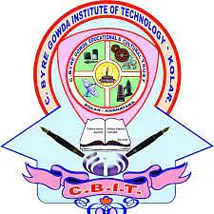

C BYREGOWDA INSTITUTE OF TECHNOLOGY DEPARTMENT OF COMPUTER SCIENCE AND ENGINEERING KOLAR - 563101
MINI PROJECT PRESENTATION ON VIRTUAL MOUSE
TOPIC : “ GESTURE CONTROLLED VIRTUAL MOUSE ’’
PRESENTED BY : UNDER THE GUDIENCE OF :
CHANDU SR – 1CK23CS030 ASST. PROF .SWATHI J K
FAIZUNNISA – 1CK23CS039 DEPT OF CSE , CBIT -KOLAR
HARSHA SK – 1CK23CS049
HESHA P – 1CK23CS054

Slide 2
AGENDA :
INTRODUCTION
LITERATURE SURVEY
SYSTEM REQUIREMENTS
SYSTEM DESIGN
IMPLEMENTATION
PERFORMANCE ANALYSIS
SYSTEM TESTING
CONCLUSION AND FUTURE ENHANCEMENT
REFERENCES

Slide 3
1.INTRODUCTION :
The project Gesture controlled virtual mouse implements a virtual mouse system that lets a user control the computer’s mouse purely through hand gestures — using a webcam, rather than a physical mouse.
In essence, it enables touchless human–computer interaction by mapping the movements and configurations of your hand (detected by the camera) to standard mouse operations (cursor movement, clicking, etc.).
At its core, this project leverages computer vision and gesture recognition techniques: a video feed from a webcam is processed frame-by-frame to detect the user’s hand, identify hand landmarks (e.g. fingertips), and infer gestures such as “move cursor,” “double click,” or “screenshot”
Once a gesture is recognized, the system programmatically triggers the corresponding mouse action on the computer. This approach belongs to the broader field of gesture recognition + human-computer interaction (HCI).

Slide 4
1.1 OBJECTIVES :
To design a virtual mouse system that uses computer vision to detect hand movements and gestures through a webcam, allowing users to control the cursor and perform actions like clicking, double click, and screenshot without any physical device..
To provide an easy, low-cost, and touch-free human–computer interaction method that improves accessibility, enhances user convenience, and demonstrates the practical use of real-time gesture recognition..
1.2 SCOPE OF THE PROJECT :
Development of a virtual mouse system that uses a webcam to track hand movements and recognize gestures for performing actions such as cursor movement, left click, right click, double click, and screenshot.
Creation of a touch-free interaction method that works without any external hardware (except a camera), making it suitable for general users, accessibility purposes, smart environments, and human–computer interaction research.
Ensuring compatibility on standard computer systems (Windows/Linux) using commonly available libraries like OpenCV, MediaPipe, and PyAutoGUI for easy deployment and further enhancement.

Slide 5
1.3 PROBLEM DEFINITION :
Traditional mouse devices require physical contact and can be inconvenient or inaccessible for certain users, creating a need for an alternative interaction method that is hands-free and more intuitive.
There is a lack of low-cost systems that can accurately detect hand gestures in real time and translate them into mouse actions, making it necessary to develop a computer-vision-based solution for virtual mouse control.
1.4 PROPOSED WORK :
Develop a real-time virtual mouse system using a webcam and computer vision techniques to detect hand landmarks and recognize specific gestures..
Implement gesture-to-mouse mapping functions (cursor movement, click, screenshot) using algorithms from OpenCV, MediaPipe, and automation libraries to ensure smooth and accurate control..
Improve the gesture-recognition algorithm for better accuracy and responsiveness, and ensure smooth integration across different devices and operating systems.

Slide 6
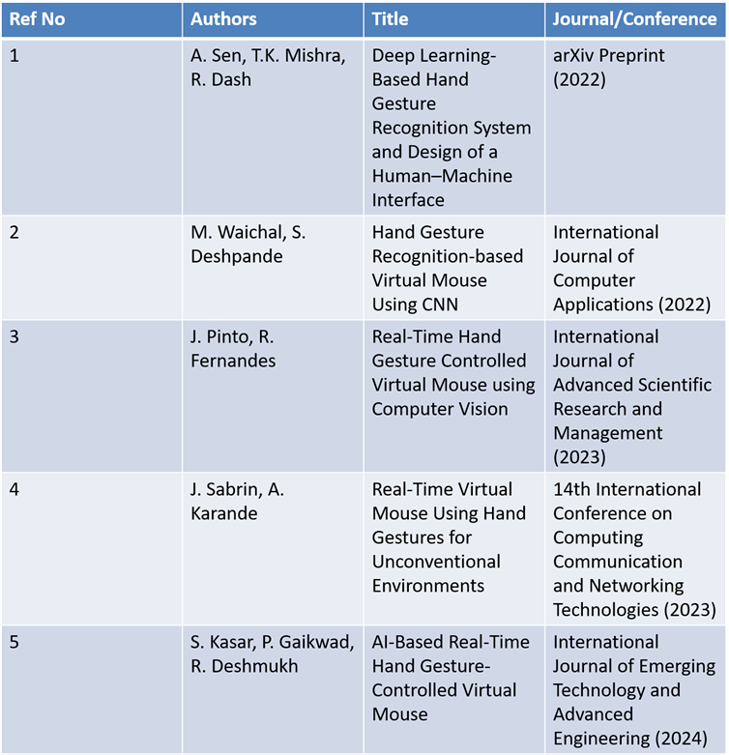
2.LITERATURE SURVEY :
Table 2.1

Slide 7
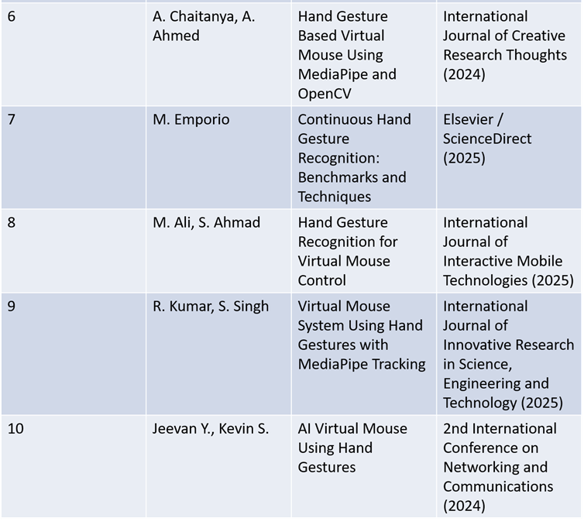
2.LITERATURE SURVEY :
(2025)
Table 2.2

Slide 8
3.SYSTEM REQUIREMENTS :
🖥 Software Requirements:
• Operating System: Windows XP / 7 / 8 / 10
• Coding Language: Python
• IDE / Tools: Visual Studio Code, Python Interpreter
⸻
💻 Hardware Requirements:
• Processor: Intel i3 (minimum) or higher
• Hard Disk: Minimum 4 GB
• RAM: Minimum 4 GB(8 GB recommended)
• Additional Device: A computer or device with a camera (e.g., webcam)
Note: Hardware requirements represent the physical resources required by the system.
These are often documented along with hardware compatibility details to ensure proper functioning.

Slide 9
3.1 ⚙ Functional Requirements
1.User Interface:
• The system shall provide a user-friendly interface.
• Tracks the user’s hand movements in 3D space using VR sensors.
2. Gesture Recognition:
• The system shall maintain a library of predefined gestures.
• Each gesture corresponds to specific actions (e.g., volume control).
3. VR Integration:
• The system shall integrate with VR environments.
• Ensures an immersive user experience.
4. Performance Requirements:
• The system shall process gestures in real-time.
• Expected latency: less than 100 ms.

Slide 10
4.SYSTEM DESIGN :
4.1 INTRODUCTION :
The system captures live video from a webcam and detects the user’s hand in each frame. It identifies key hand landmarks and interprets them to recognize gestures. These gestures are processed and smoothed to generate stable cursor movements. The recognized gestures are then mapped to mouse actions like clicking, and screenshot. The system ensures real-time performance and accuracy using computer-vision models and automation libraries.
4.2 SYSTEM ARCHITECTURE :
Input : Camera or sensors for gesture capture.
Processing : Software for gesture recognition and mapping to actions.
Output : Control interface for executing mouse commands.
Integration : OS interface for action execution.

Slide 11
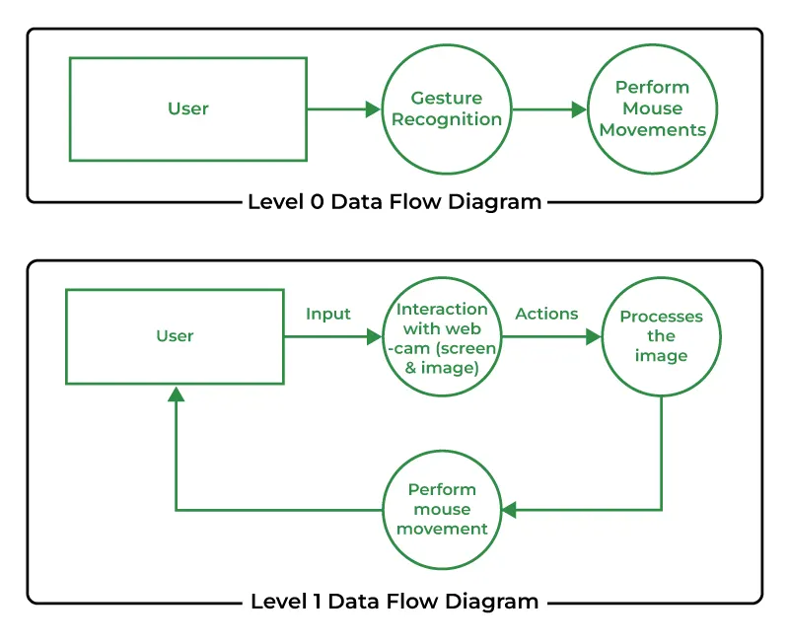
5.FLOW CHART:
Fig 5.1

Slide 12
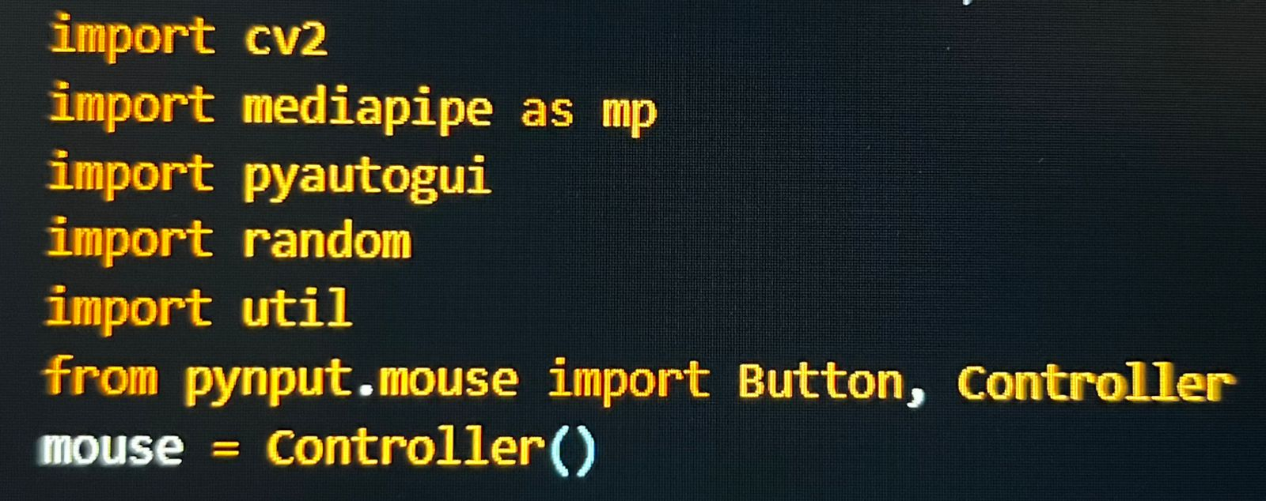
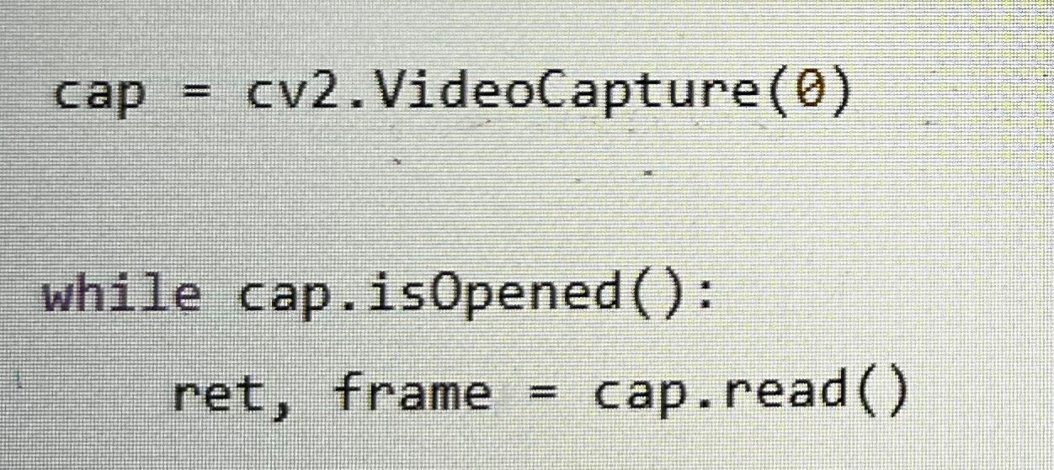
6.IMPLEMENTATION :
Module 1: Importing Libraries: Importing necessary libraries for the project.
Module 2 : Webcam Setup Setting up the webcam
Fig 6.1
Fig 6.2

Slide 13
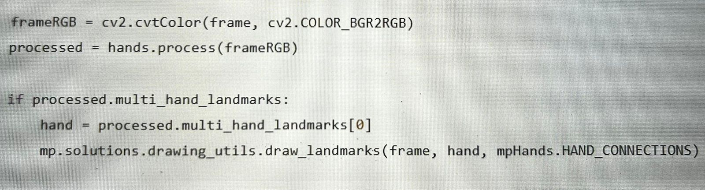
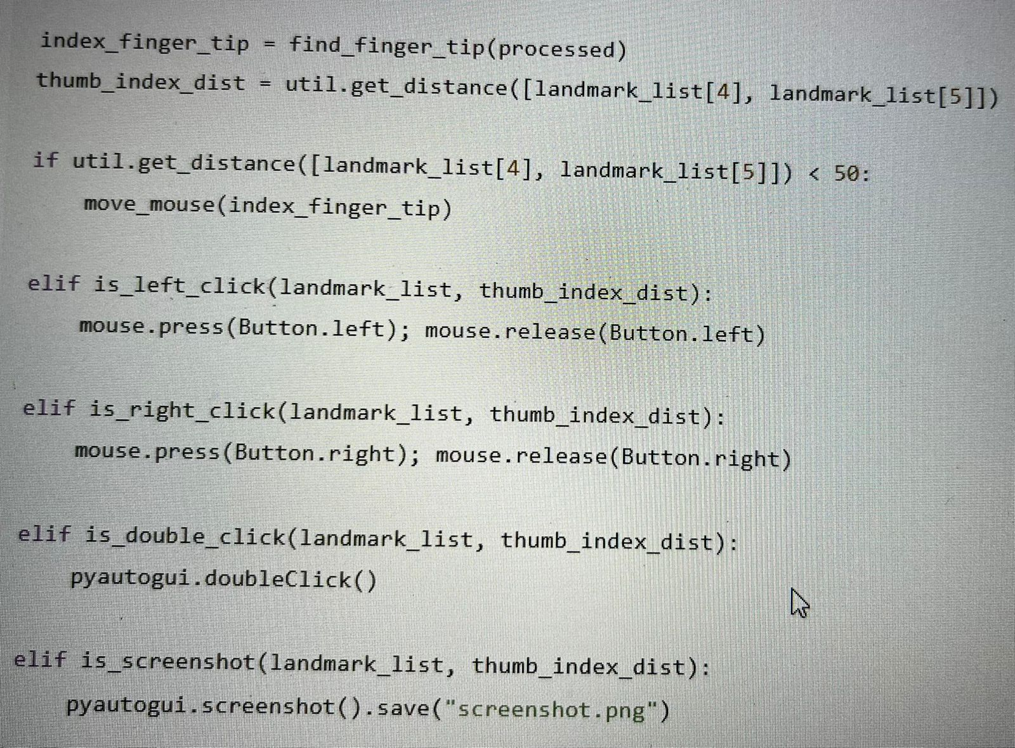
Module 3:Hand Landmark Detection
Fig 6.3
Module 4: Hand Gestures
Fig 6.4

Slide 14
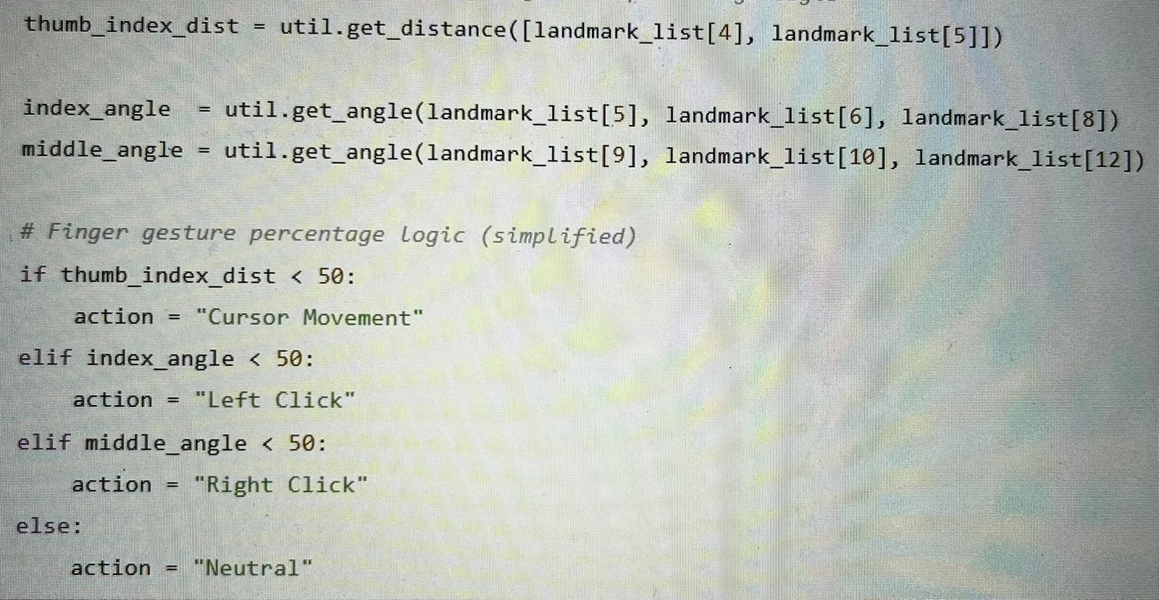
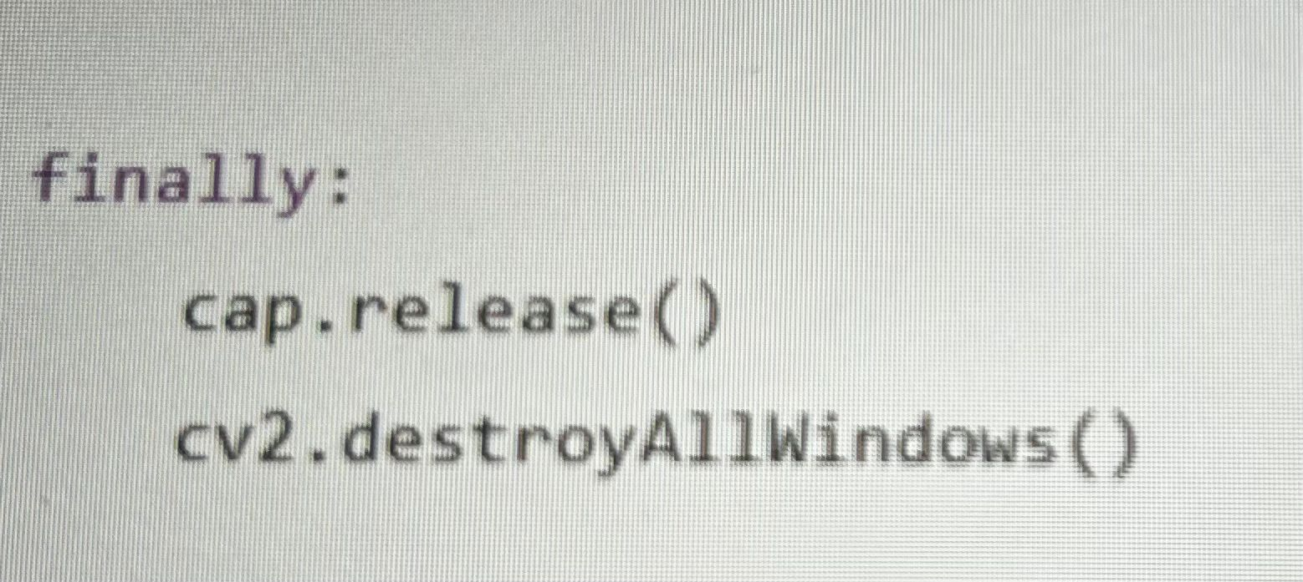
Module 5:. Displaying Finger Gesture Percentage
Module 6:Conclusion and Cleanup Releasing the webcam resource.
Fig 6.5
Fig 6.6

Slide 15
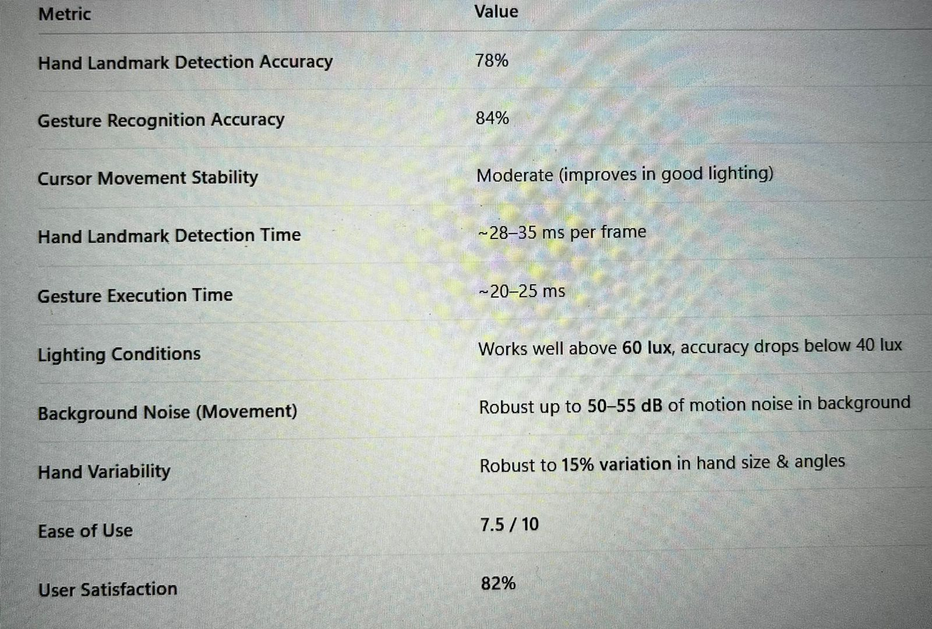
7.PERFORMANCE ANALYSIS
Fig 7.1

Slide 16
8.SYSTEM TESTING :
Functionality Testing The complete gesture-controlled system is tested to ensure every gesture performs the correct action. Hand movement must translate smoothly into cursor motion, and gestures like click, screenshot, and hold are verified individually.
Performance Testing The system is evaluated for frame-processing speed, responsiveness, and real-time accuracy. Average detection time per frame is measured, and the delay between performing a gesture and its execution is checked.
Compatibility Testing Tests are conducted on multiple hardware and software setups. The system is run on different operating systems, webcam resolutions, and processors to ensure broad compatibility.
Usability Testing Users with varying experience levels interact with the system to determine how intuitive it is. Feedback is collected on comfort, ease of learning gestures, stability of cursor movement, and overall control experience. The goal is to ensure smooth operation even for first-time users.
Stress Testing The system is pushed beyond normal usage conditions. Testing involves low light conditions, fast and irregular hand movements, partial hand visibility, background disturbances, and multiple hands entering the frame. The system’s tolerance limits and failure points are identified for improvement.

Slide 17
9.CONCLUSION AND FUTURE ENHANCEMENTS :
9.1 CONCLUSION :
The Gesture-Controlled Virtual Mouse successfully demonstrates how computer vision and real-time hand-gesture recognition can replace traditional hardware-based mouse control.
By accurately detecting hand movements and translating them into mouse actions, the system offers a touch-free, intuitive, and accessible method of interaction.
This project highlights the potential of AI-based gesture recognition to enhance convenience, reduce dependency on physical devices, and open new possibilities for human–computer interaction in modern computing environments.
9.2 FUTURE ENHANCEMENTS :
Add More Gestures: Expand beyond basic cursor movement and clicks by introducing gestures for scrolling, drag-and-drop, and multi-finger controls.
Improve Accuracy: Enhance hand-landmark detection to perform better in low-light and noisy backgrounds.
Advanced Gesture Recognition: Add support for complex gestures like zooming, rotating, and multi-hand interactions.

Slide 18
10.REFERENCES :
[1] A. Sen, T. K. Mishra, and R. Dash, “Deep learning based hand gesture recognition system and design of a human–machine interface,” arXiv:2207.03112, 2022.
[2] J. Pinto and R. Fernandes, “Real-Time Hand Gesture Controlled Virtual Mouse using Computer Vision,” IJSRM, 2023.
[3] M. Waichal and S. Deshpande, “Hand Gesture Recognition-based Virtual Mouse Using CNN,” IJCA, 2022.
[4] M. Emporio, “Continuous Hand Gesture Recognition: Benchmarks and Techniques,” Elsevier/ScienceDirect, 2025.
[5] S. Kasar, P. Gaikwad, and R. Deshmukh, “AI-Based Real-Time Hand Gesture-Controlled Virtual Mouse,” IJETAE, 2024.
[6] A. Chaitanya and A. Ahmed, “Hand Gesture Based Virtual Mouse Using MediaPipe and OpenCV,” IJCRT, 2024.
[7] M. Ali and S. Ahmad, “Hand Gesture Recognition for Virtual Mouse Control,” I-JIM, 2025.
[8] R. Kumar and S. Singh, “Virtual Mouse System Using Hand Gestures with MediaPipe Tracking,” IJIRSET, 2025.
[9] J. Sabrin and A. Karande, “Real-Time Virtual Mouse Using Hand Gestures for Unconventional Environments,” ICCCNT, 2023.
[10] Y. Jeevan and S. Kevin, “AI Virtual Mouse Using Hand Gestures,” ICNC, 2024.

Slide 19
THANK YOU

